Slide 1
Who, What, Where, When, and How
Piecing Together the Colorado Digital Landscape to Tell a Bigger Story of Our History
Marmot User Group Conference, Grand Junction. October 5, 2017
Leigh Jeremias, Digital Collections Coordinator, Colorado State Library
Regan Harper, Director of Networking and Resource Sharing, Colorado State Library

Slide 2
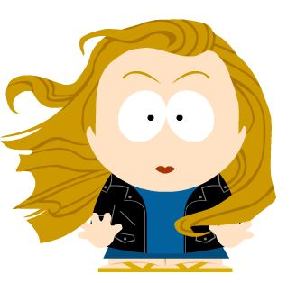
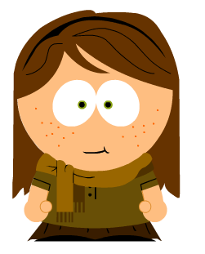
Who are We?
Library Perspective
Museum Perspective
Leigh Jeremias
Regan Harper
Notes:
Who are we? I am Regan Harper and I am the Director of Networking and Resources Sharing for the Colorado State Library. The Networking and Resources Sharing team are the people that manage cooperative technology initiatives within the state, which includes the initiatives that involve digital collections. We maintain the Colorado Historic Newspaper Collection, which is currently in its 12th year of existence, and also the newly formed Plains to Peaks Collective, which we will discuss more in a moment. With me today - is Leigh Jeremias, who is the Digital Collections Coordinator for the State Library, and is the project manager for both the CHNC and PPC program. One of the things that makes our partnership so effective in the digital programs that we manage is that we come at our work from complementary, yet differing viewpoints. I have 29 years experience in libraries and with digital collections in libraries, and Leigh has a museum background and has been working in museums and special collections for her entire career. I can talk and translate library and she can talk and translate museum.

Slide 3
Colorado’s Digital History
How it all began
Notes:
A number of years ago, I attended a presentation at the Rocky Mountain Special Library Association Membership Meeting that was given by Erik Beck from the University of Colorado Law Library. He did an outstanding job summing up the history of Digitization within the state that I am going to blatantly pilfer from here and share with you a rapid summary of how it all came about. What were our foundational activities that helped form our current situation and landscape and most importantly - outlook.
One quick caveat - this is meant to be a summary. I want to provide you all with an overview of how we came to be where we are, not to provide set in stone details that will cause people to engage in fisti-cuffs if not minutely accurate. And with my disclaimer out there - lets talk about the digital timeline of our state.

Slide 4
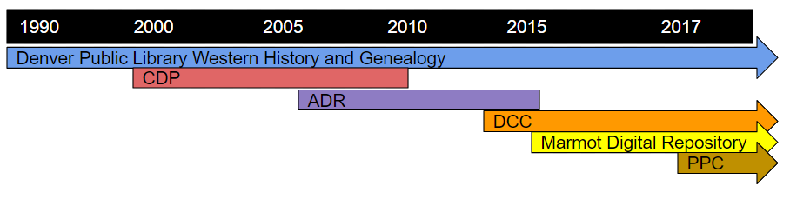
History of Major Digitization Projects
within Our State
CDP = Collaborative Digitization Program
ADR = Alliance Digital Repository
DCC = Digital Collections of Colorado
PPC = Plains to Peaks Collective
Notes:
The first big digitization project in the state came from Denver Public Library. Agostino Mastoguiseppe had an idea to preserve and improve access to their special collections by creating surrogate copies. They got grant funding, purchased equipment - and blazed a trail, eventually digitizing more than 35,000 item, accompanied by 35,000 MARC records. Remember: there were no best practices or standards at this time - so they gravitated to the thing they knew best - MARC. They got a NEH grant in 1984 for the initial project, and the first image appeared in 1985. In 2001, they had worked out the kinks and transferred the project from grant funding to sustainable internal funding, and migrated to CONTENTdm as their Content Management System by 2010.
DPL faced many challenges, such as metadata, equipment, standards, permissions, ownership, and much more - but they forged ahead and made a huge impact on the hearts and minds of others within the state. Specifically folks at the State Library. Discussions ensued amongst the higher ups as to why there was not a state infrastructure to share collections and knowledge about the digitization process. Out of these discussion came the Colorado Digitization Project or CDP.
The purpose of CDP was to fill a coordination and guidance role to other agencies digitizing materials within the state. They were also tasked to develop standards, provide training, and share equipment to be used in the digitization workflow.
And finally, and probably the most difficult part - to provide a single access point to discover the collections from the disparate institutions participating.
They were funded from 1999 to 2004 by grants from LSTA grants to states, IMLS Leadership and Education grants, Colorado Historic Fund grants, NEH grants, totaling roughly 2.5 million dollars.
The CDP did a lot of great things, creating best practices, creating Heritage West digital Collection, the sound model collection, they introduced uniform standards, established a model of collective action, and got everyone digitizing. But grant money was no longer as plentiful and the CDP broke up, around 2009/2010.
The Colorado Alliance began their digital repository in 2006 with 14 academic and state institutions contributing to their Islandora database. However, due to high costs and technology issues, institutions began dropping out and going their own way or forming other alliances like the Digital Collections of Colorado, and the ADR was dissolved in 2015. What happened at this point was that many of the institutions that had remained part of the ADR needed to find their own way. Some institutions had already formed alliances. Some went their own way initially, but moved closer to share services later on. And new entities began to come together to make new alliances and share collections in a completely different way like the Marmot Digital Repository.
I am married to an Astrophysicist, so outer space and cosmic activity play an important part of my daily life, and I could not help but equate some of this associating and dissociating of entities to astrophysical activity. Our environments are not static but are part of an ecosystem that is constantly changing – and our digital history is not exception. All this activity is all just star stuff in our timeline, but it’s the way that the star stuff settles and comes together to form new entities that brings us to where we are now in 2017.

Slide 5
Colorado’s Digital Landscape
Working together or alone we are all part of the bigger picture.
Notes:
Let’s look at a snapshot of our current landscape.

Slide 6
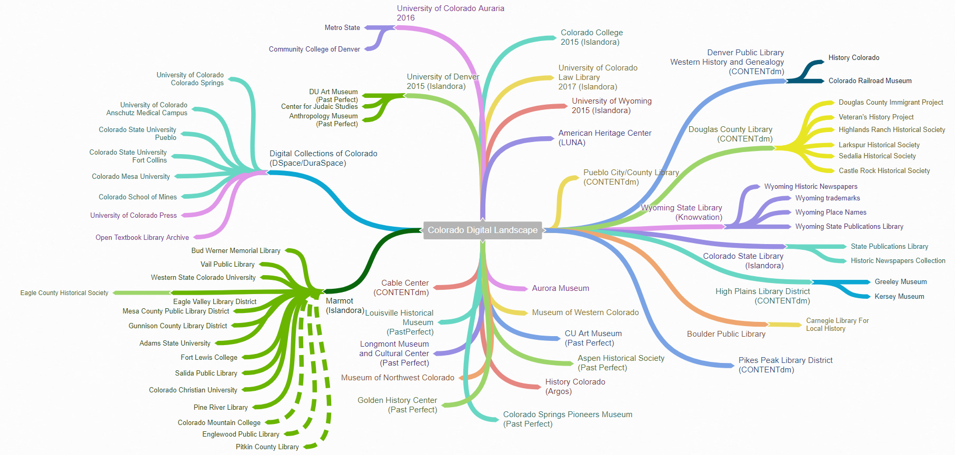
Big Picture View of the Digital Landscape
Notes:
Here is a sample of what is currently going on in our digital landscape. I have done my best to represent the relationships that are currently playing out in the state’s digital community, but I know that it is only a sample of what is really going on. However - I think it serves to help illustrate the depth and variety of relationships and participation in our shared digital community.
Public and State Agencies
University Entities on their own
Large active consortial groups
Single unassociated museums and archive.
Lets look more closely at some of these relationships and associations.

Slide 7
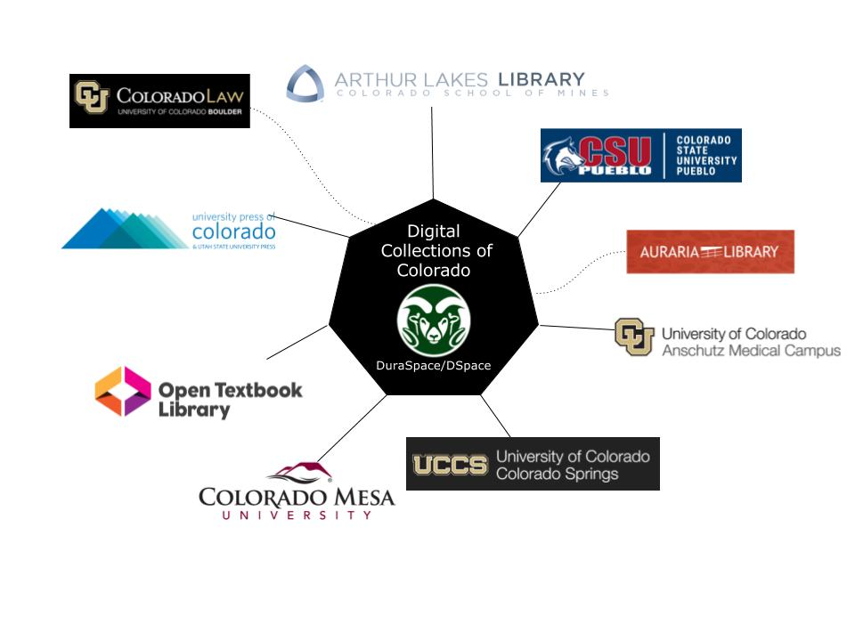
Consortial Landscape 1: Digital Collections of Colorado (Membership Group)
Notes:
The Digital Collections of Colorado Group is a member organization that was formed in 2015 out of academic institutions that had left the Alliance’s ADR. THe group is maintained by CSU Fort Collins, and initially included both CSU campuses, four CU campuses, School of Mines, Colorado Mesa University and the University Press of Colorado. A year later, Auraria Library left to pursue its own autonomy, and was then followed by CU Law the following year. The Open TextBook Library then joined the group. This is a great example of the dynamic nature of these groups. Entities come and go as needed, but provided the overall balance is right, the collaborative will continue throughout the momentary disruptions.
An important thing to point out here in this group is that the individual components or entities retain their own identities within the collection. Searching the shared collections brings you back to the individual institution, and the institutions contacts and branding. The cooperative is for functionality, and allows for individuality and branding identity. I think this is an important aspect of today’s collaborations. It is not a matter of taking away, but of providing more.

Slide 8
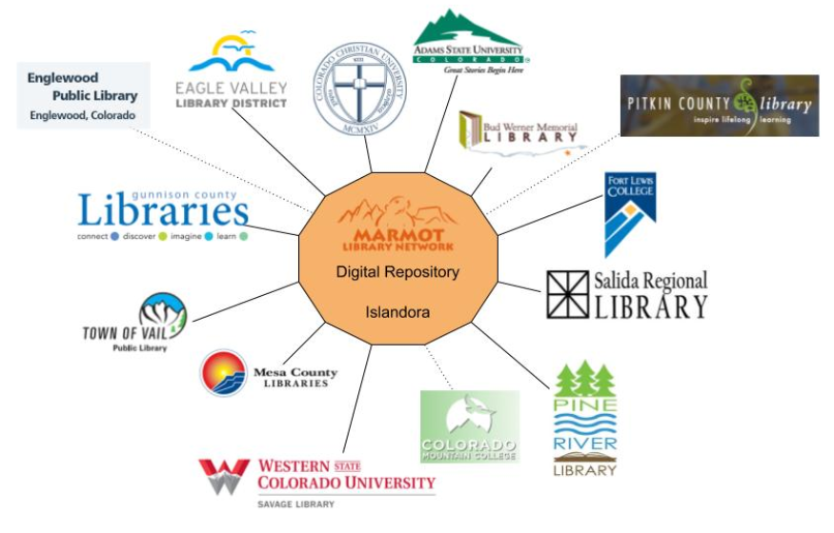
Consortial Landscape 2: Marmot Digital Repository (Membership Group)
Notes:
Another great example of a collaborative is the MARMOT Digital Repository. There are currently eleven participating institutions in the shared repository, and three more in active development. Again, the purpose of this collaborative is to share infrastructure - but discovery is focused around the individual institutions collection as a whole (books, digital objects, recordings) and the individual institution participating.

Slide 9
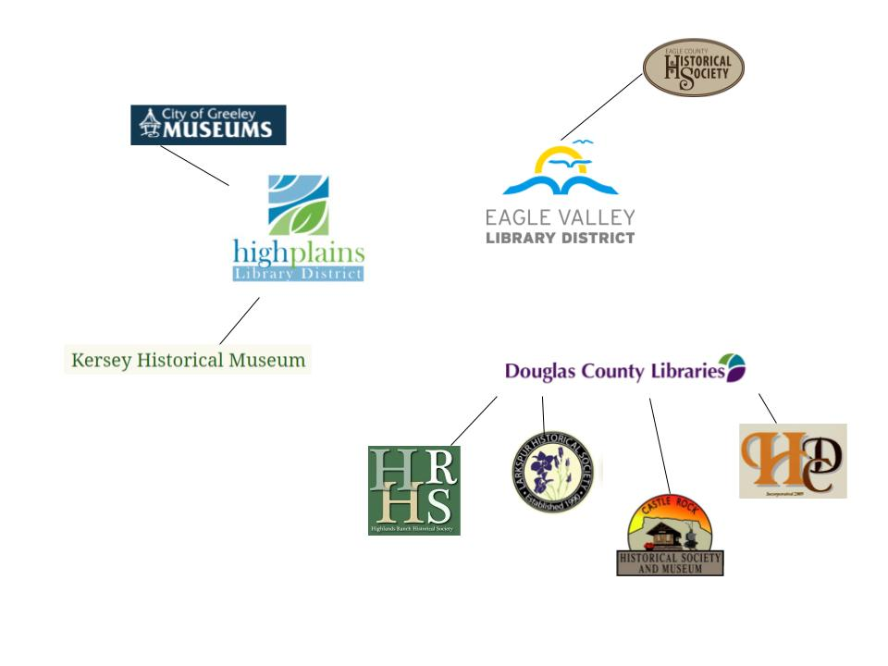
Landscape 3: Local/Regional Collaborations (Guardian)
Notes:
This next group - is what we call a guardian relationship. Larger institutions like High Plains Library District and Douglas County Libraries have formed partnerships to help their less able neighbors get their collections online. These collections are absorbed, however, into the collection and infrastructure of the Guardian institution. Getting these smaller collections online helps create a greater scope of the information being shared, but it is also provides tremendous assistance to the smaller organization by giving them something they could not support alone.
There are many more of this kind of relationship out in the present landscape - but these are just a few to illustrate.

Slide 10
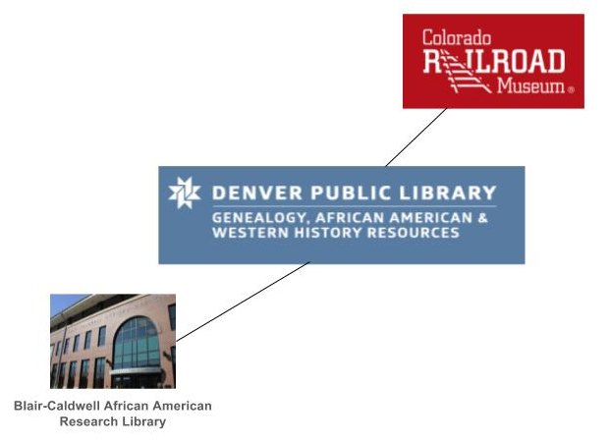
Landscape 4: Topical/Collection Based Collaborations (Story Telling)
Notes:
The next type of collaboration is what we call collection based, with the motivation being - deepening the story being told. A larger institution, in this case Denver Public Library, assists a smaller institution to digitize all or part of their collection, as it fits in closely with their own collections, and by including it - provides a richer experience for the user. Again, the collection is not really intended to maintain a unique branding - but is absorbed somewhat into the collection of the larger institution. Like with the Guardian relationship, the smaller entity could not make a go of it on their own, so this symbiotic relationship helps both parties reach a greater audience, and provide a more rewarding discovery experience.

Slide 11
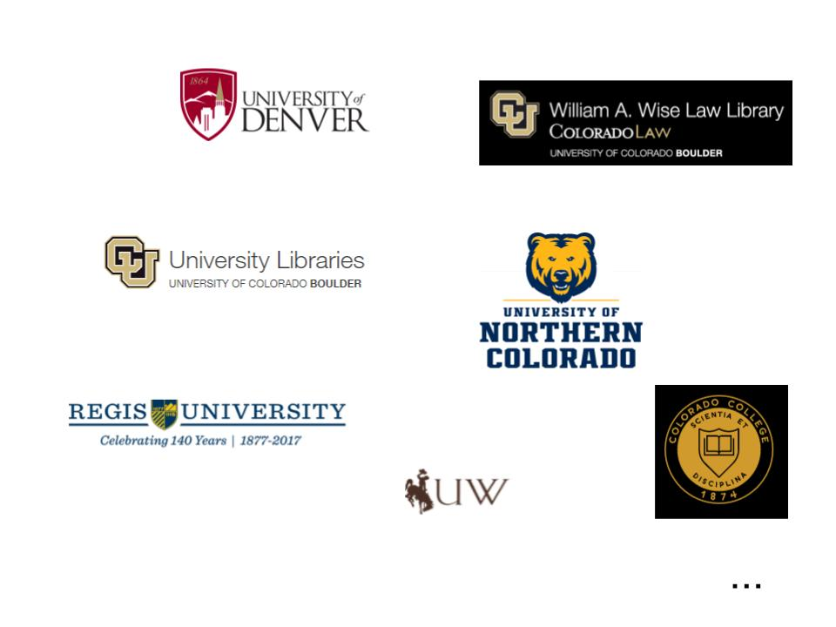
Landscape 5: The Independent Academics (Lone Samurai)
Notes:
Now we more into the area where we are no longer looking at organized official collaborations. This is not to say that these institutions do not collaborate together on some things - like tech support and advice - but they are currently without a formal shared infrastructure. In the academic environment - we have dubbed these institutions the Lone Samurai - skilled, and powerful, but without a shared association.
All of these institutions listed - and more not listed, have made the choice to separate from the pack for whatever reason and are running their own repositories. They communicate with each other and share technology skills and ideas, but their systems are independent, and they are making their own decisions regarding their digital future.

Slide 12
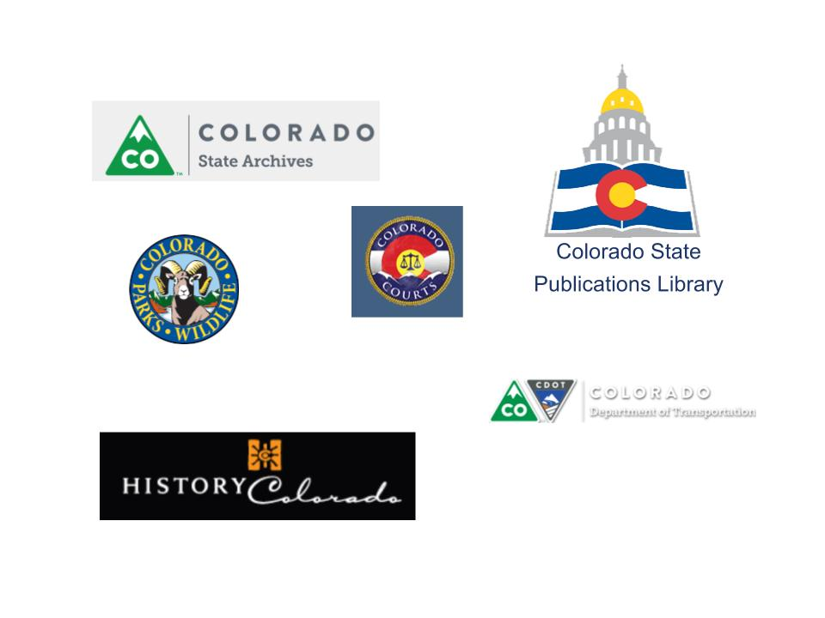
Landscape 6: State/Government Agencies
Notes:
Government Agencies within the state are similar in their separated isolated existence. There was talk at one time of finding a way to bring these entities together under a shared digital initiative, but there has been little to no movement on this project, so am not expecting miracles to happen any time soon. All of these state entities are running different platforms, so joining as one does not seem likely.

Slide 13
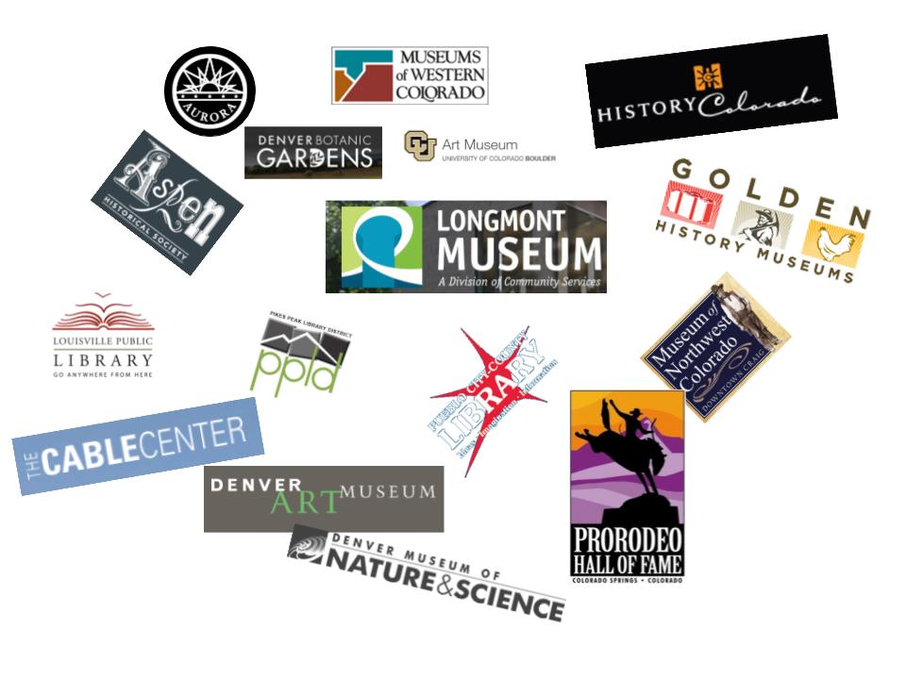
Landscape 7: Independent Museums, Historical Societies & Libraries
...
Notes:
And then - we have all of the smaller individual libraries, museums and archives that are running their own instance of Past Perfect or Luna or CONTENTdm. They are dealing with the issues that come up with digitization in isolation, like metadata, limitations in skills and resources, lack of equipment and training, rights management and more. This is just a handful of cultural heritage institutions that fall into this grouping. They are by far the largest group playing in this landscape, and the hardest to interact with. You have to know they are out there in order to discover what they have and that is not always easy to do.

Slide 14
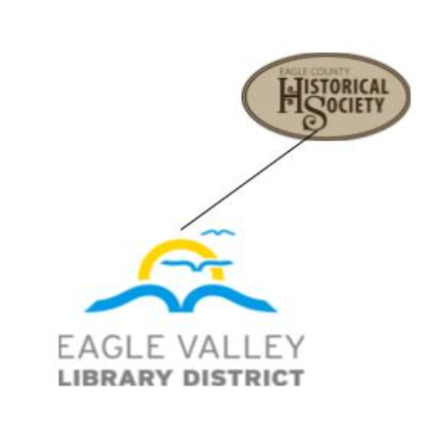
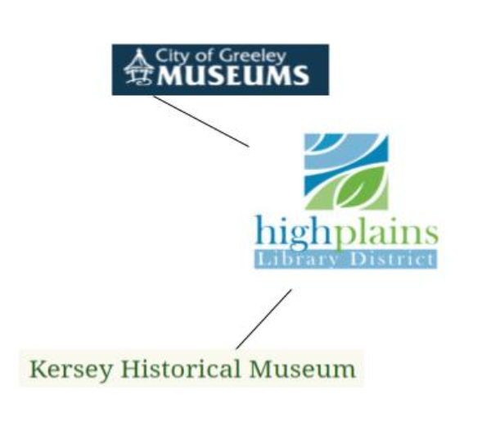
What Do We Do Next?
+
+
+
+
+
+
= ?
+
+
Notes:
So it is clear that although Colorado collectively has a large digital presence, it is not organized in a way that makes sharing and discovery easy. How can be change the relationships to allow the institutions to retain their valued autonomy, and yet still benefit from the resources, skills, knowledge of others. And, more importantly - how can this change in associations enable us to make all of our collections deeper by sharing our stories with each other and the nation as a whole.
I am going to turn this over to Leigh now as she looks at where we are going from here.

Slide 15
The National Landscape
Colorado’s Growing Footprint
Notes:
As Regan has shown, Colorado has a long history of digital initiatives and our landscape is vast and growing. Let's now talk about how we are effectively and efficiently bringing those parts together to grow our national footprint while we still maintain our own identity.

Slide 16
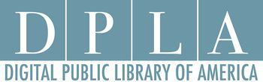
What is the DPLA?
Notes:
We can’t talk about this and the national digital landscape without talking about the Digital Public Library of America. I’m sure many of you know what the DPLA is so I will only talk about it briefly. The DPLA is a national platform that aggregates -in other words brings together- collections from participating institutions in the United States. Those participating institutions share their metadata or descriptive information with the DPLA. Every institution holds a piece of our shared history, the DPLA works to bring these pieces and stories together. This Initiative was started in 2010 and led by institutions such as the Haithitrust and LOC, among others. They started with numerous funders including IMLS, Sloan, Mellon, NEH, the Knight foundation and even received support from a private donor. The DPLA went live with the first collections in 2013.

Slide 17
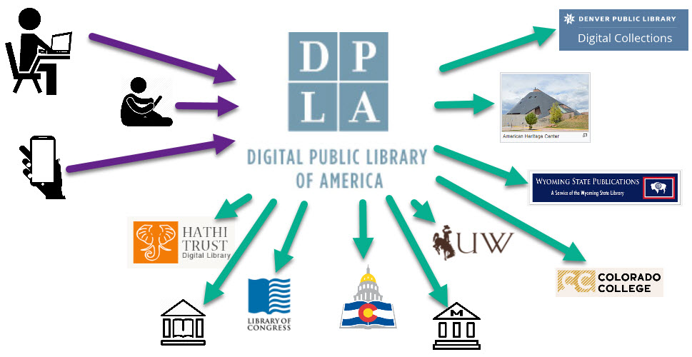
How it Works
Notes:
So how does it work? Wherever a user is online; either at home, at the library or on their phone they can search the DPLA. It is free to use and openingly available to anyone with an internet connection. The DPLA portal acts as a discovery tool that allows users to discover and then go directly to the digital collections housed in your local online repository. This allows you to share collections on a national level while maintaining your own identity. It also allows one stop shopping for users. No longer does a user need to know the exact location of the items they are looking for. As good as we are about sharing and promoting our collections, they are still hard for even the most avid researcher to find. The DPLA enhances our discoverability and brings together the collection silos that exist.

Slide 18
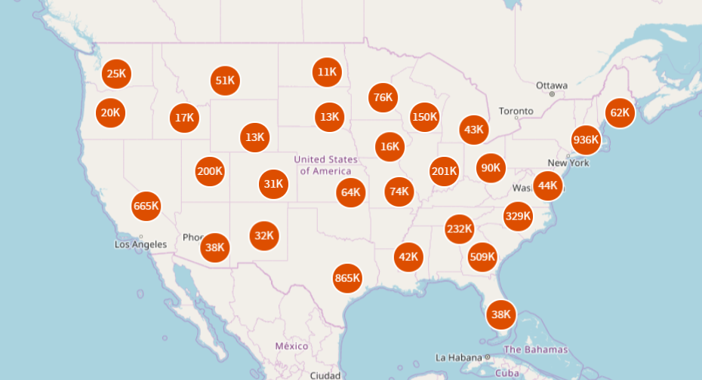
Notes:
This Map represents the current summary of items included in the DPLA by state of context – NOT state of ownership. There are 21k items in the DPLA that relate to Colorado according to their metadata - this means they could relate by subject or geographic area. There are 8K items that relate to Wyoming. Wyoming has one participating library in the DPLA - the Buffalo Bill Center of the West – via Mountain West Digital Library in Utah. Currently Colorado has no participating institutions. That means that 21k items that relate to Colorado are being shared but none of those items are owned by Colorado institutions. We want to change that and clearly we have collections available to do that. By participating in the DPLA we can increase these numbers for Colorado and Wyoming and thereby increase our national footprint.

Slide 19
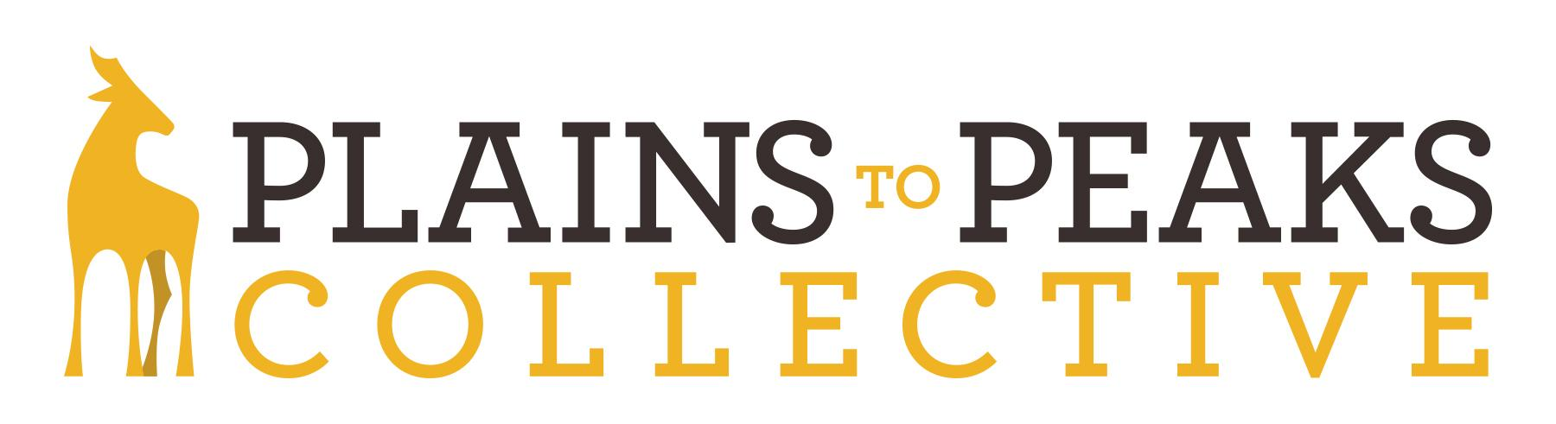
Notes:
In order to give institutions in Colorado and Wyoming an opportunity to participate in the DPLA and increase those content numbers, we needed to develop a DPLA Service hub, the Plains to Peaks Collective. Currently the DPLA has 45 hubs with a total of 2350 participating institutions. In 2014 a group of representatives from Libraries, archives and museums in Colorado and Wyoming came together to discuss participation in the DPLA. It was decided at that time that institutions in our two states were ready to participate at this national level alongside everyone else including the bigs guys such as the Smithsonian and the Library of Congress. The Colorado State Library was chosen to lead and organize this initiative.

Slide 20
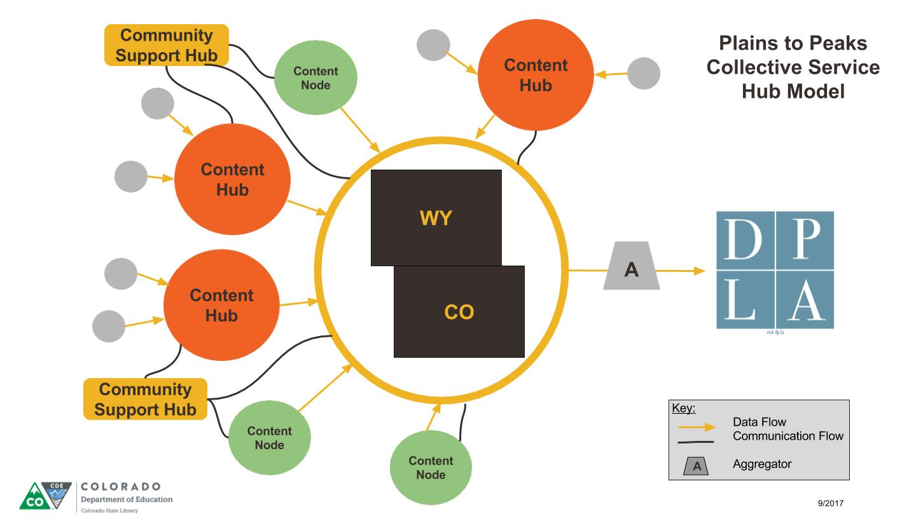
If you build it they will come……..
Notes:
So decision made, the next steps are easy, right? What followed was a lot of research and discussion with other existing state hubs. What we found fairly quickly was that there was no one-size-fits- all state model. Each state Hub is different because the structure and the needs of each state are different. We decided early on that a goal of the PPC was to develop a program where every institution, regardless of size or digital capabilities, had the opportunity to participate in the DPLA. This goal was shared by the members of our planning group. We developed a model with different levels of participation and multiple avenues of support. Content Nodes, represented in this model by the green circles, are institutions that will only supply their own content to the PPC. Community Support Hubs, represent in gold, are organizations that represent and support institutions that are part of their membership or community. It is anticipated that these partners are not direct content providers but provide support services to their communities in the form of communication, facilitation and education. Content Hubs, represented in orange, are institutions that share their own metadata but also support the participation of other institutions that may not have the ability to do so on their own. They do this through one or more of the following ways: collection hosting and storage, digitization services, education and training, and Metadata remediation. They also act as the primary liaison between the PPC and their affiliates, represent as the grey circles. It's our hope that everyone can find their own fit in this model for the betterment of the project as a whole.

Slide 21
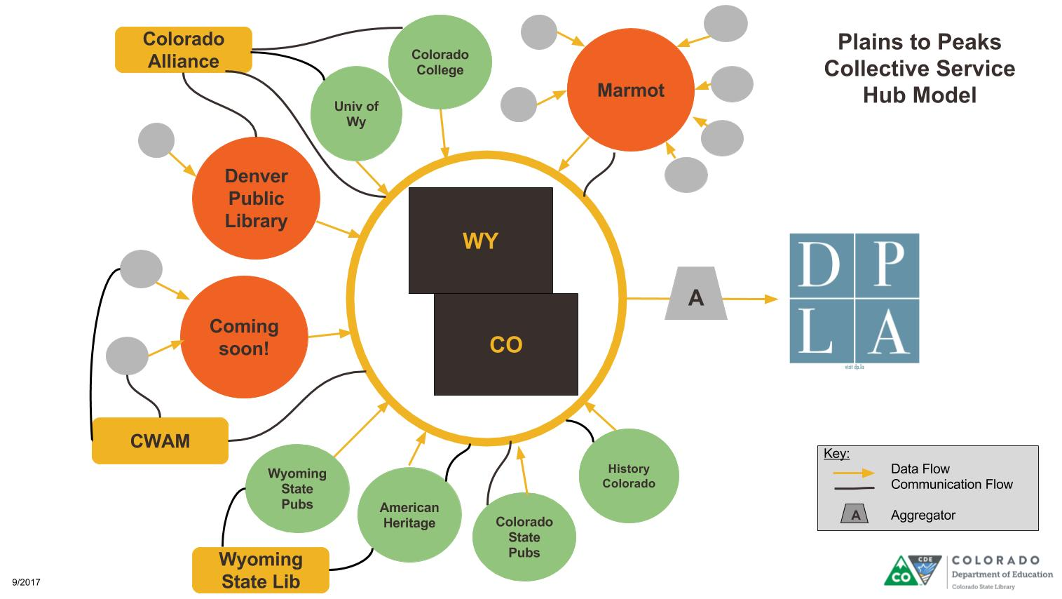
The PPC is built on Collaboration
Notes:
The PPC is built on collaboration. We have eight partner institutions; the Denver Public Library, Colorado College, University of Wyoming, the American Heritage Center, Wyoming State Publications, History Colorado, Colorado State Publications and Marmot. We have also developed relationships with three community support partners; the Wyoming State Library, the Colorado-Wyoming Association of Museums, and the Colorado Alliance who we use as our liaison with their members. Marmot falls somewhere between a content provider and a support partner. You are sharing the data of your member organizations but also supporting their participation through outreach, communication and education. You can see from this drawing that one circle says “Coming Soon.” Our goal is to increase the number of institutions that are willing to support the participation of others that may not have the means to do so on their own.

Slide 22
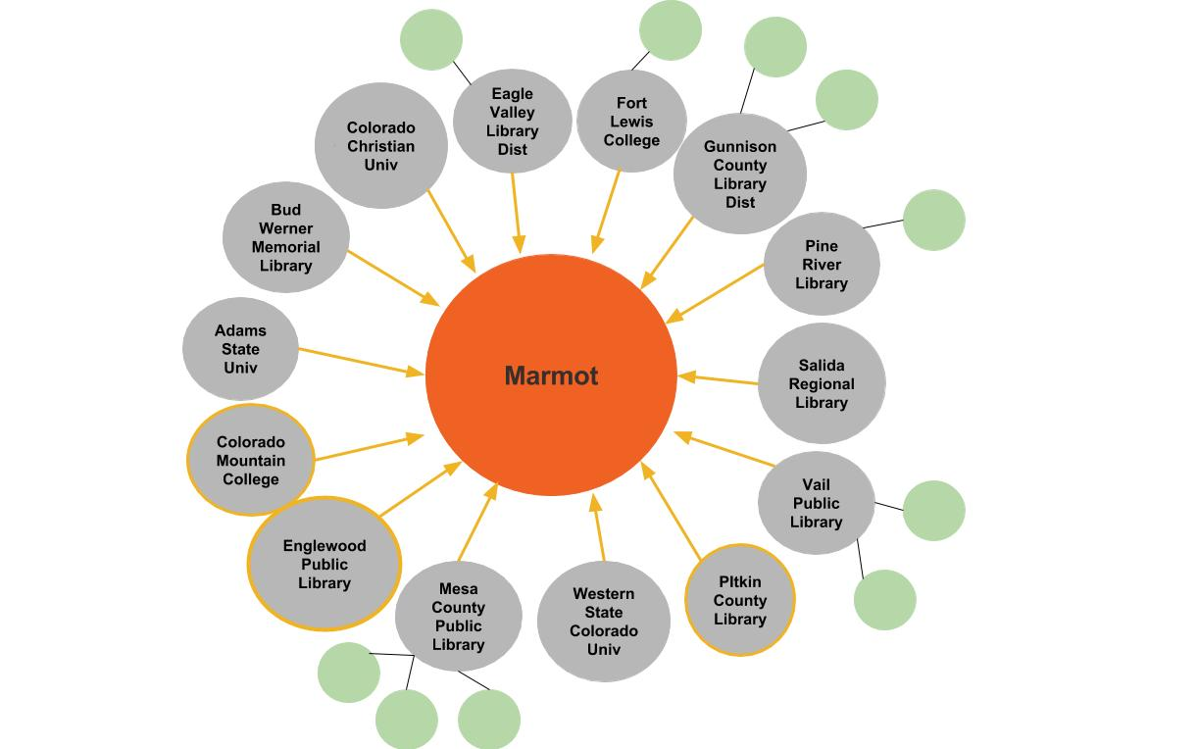
Marmot Digital Archive
Notes:
Increasing the number of content providers that are willing to support others will increase our national footprint. It will also help the PPC achieve its goal of giving every institution in Colorado and Wyoming the opportunity to participate in the DPLA. These are exactly the relationships we want to cultivate. It’s networks like Marmot that will help the PPC and the DPLA grow the Colorado footprint and increase its presence in the national story. If these types of relationships didn’t exist it would make this project unsustainable.

Slide 23
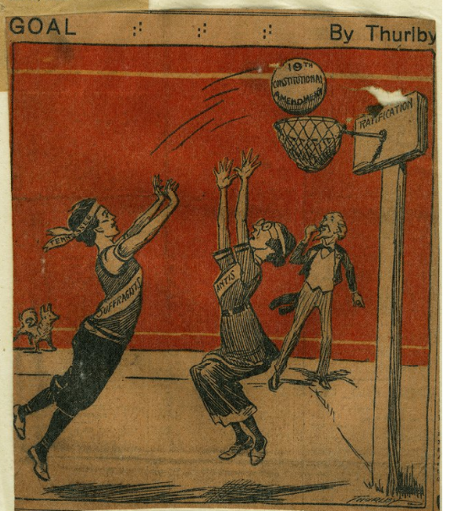
Shared Goals
Enhanced Access
Increased Visitation
Collection Scope
Promotion of the Collection, Institution, Community and Shared History
Univ. of Tennessee, http://digital.lib.utk.edu/collections/islandora/object/volvoices%3A1973
Notes:
These collaborative relationships are successful because we have shared goals. Regardless of what type of collecting institution we are, whether we’re a library, archive, historical society or museum, we share the same common goals of enhanced access, increased visitation (whether online or in-person), broadening the scope of our collections on a local, regional and national level, and the desire to promote our collection, institution, community and our shared history. Our collections are unique, we want researchers to discover them and use them. It is also no longer about just getting people through the physical door of our building. The future is online access, it’s almost the expectation these days. It also opens our collections to users that would otherwise not be able to visit us in person.

Slide 24
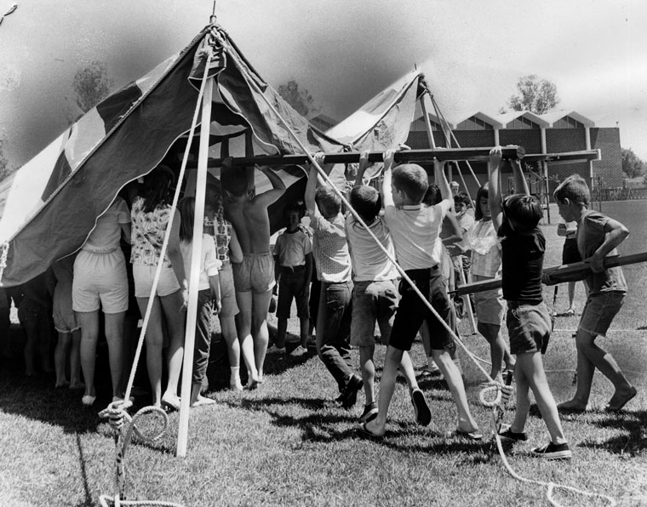
The Future is Continued Collaboration
Los Angeles Public Library, http://photos.lapl.org/carlweb/jsp/DoSearch?index=z&databaseID=968&terms=0000045094
Notes:
Colorado’s future is continued collaboration. In order to achieve our shared goals it’s important that we continue to build and foster collaborative relationships. As we can see from the earlier slides, Libraries have been very successful at building these relationships and working together to get things done. Collaborative work amongst other collecting institutions, such as Museums and Archives, has been slower to develop but is beginning to grow. We see examples of this within our own state initiatives such as the Colorado Historic Newspapers Collection. Whether it's a relationship between a library and museum; or a library and Historical Society in the same community, they are working together to digitize their community newspapers and their local history. The growth of our national digital footprint is now less about what one institution has in their collection but more about the growth of our shared regional or state collection.

Slide 25
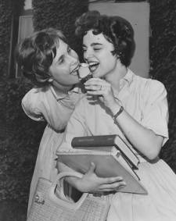
The Future is Resource Sharing
Temple University, http://digital.library.temple.edu/cdm/ref/collection/p15037coll3/id/55596
Notes:
We may not want to share an ice cream cone with each other but in order to achieve our shared goals the future needs to include resource sharing. Again in this case libraries have a long history of sharing resources which includes services, materials and/or expertise. Museums and archival institutions are often less familiar with the concept of resource sharing. However, that doesn’t mean the need is not there because these institutions, regardless of type, encounter similar challenges when embarking on a digitization project. Sharing resources such as expertise, equipment, training and sharing costs can all help increase our digital footprint.

Slide 26
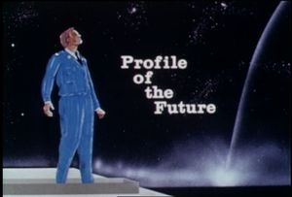
WGBH. http://openvault.wgbh.org/catalog/V_C8CBF573CDA9438CAA96CA206F1E06F0
Notes:
So what does the profile of our future look like? The growth of the Colorado’s shared national footprint relies on our past experience, the continued growth of collaboration and resource sharing, and the creative problem solving that we bring to each new challenge. It is clear that our future will allow us to be more independent of one another and more self reliant because our past experiences have given us the knowledge to do that. All of those projects that Regan discussed earlier have carried on in some way, either to another platform or as increased knowledge. We will still need to actively work together and solve problems collaboratively to grow and support our national footprint. Again our future is less about what we as individual institutions have but more about the collective history that each institution contributes to. Together our story is stronger and our contributions are more impactful.

