Slide 1
Workflow Analysis (View Outstanding Holds, Browse Query and Deletes)
MUG 2017
Friday, October 6th
Presenters: Andy Helck & Amy Sieving, Wilkinson Library; Austin Mullinex, Mesa County Libraries

Slide 2
View Outstanding Holds: What?
When?
ILS Function that allows library staff to view holds placed before a certain date
Allows staff to manage holds that are not circulating or do not reach patrons by a set date
Daily or weekly, depending on time and amount

Slide 3
View Outstanding Holds: Why?
Ensures that holds reach the holdshelf as soon as possible
Ensures that patron holds’ not needed after dates do not expire
Ensures that holds lost in transit or non-circulating holds are cancelled

Slide 4
View Outstanding Holds: How?
Open 2 ILS Sessions
1 = Set to Check Out (Circulation Desk) Function
2 = Set to View Outstanding Holds
Use View Outstanding Holds function to look up item and bibliographic information
Use Check Out (Circulation Desk) function edit patron accounts and replace their holds
Open a web browser to your catalog
-- Or --
Record Patron Names /Bib. Info and navigate between catalog & ILS

Slide 5
View Outstanding Holds: How?
1.) In ‘View Outstanding Holds,’ Click in the box “Holds Placed Before” and enter a date
2.) Under ‘Pickup Location,” select the appropriate option.
3.) Click the “View Outstanding Holds” button.
4.) For each item, right click on “Hold Status” then select “View Item" or “View
Bib”

Slide 6
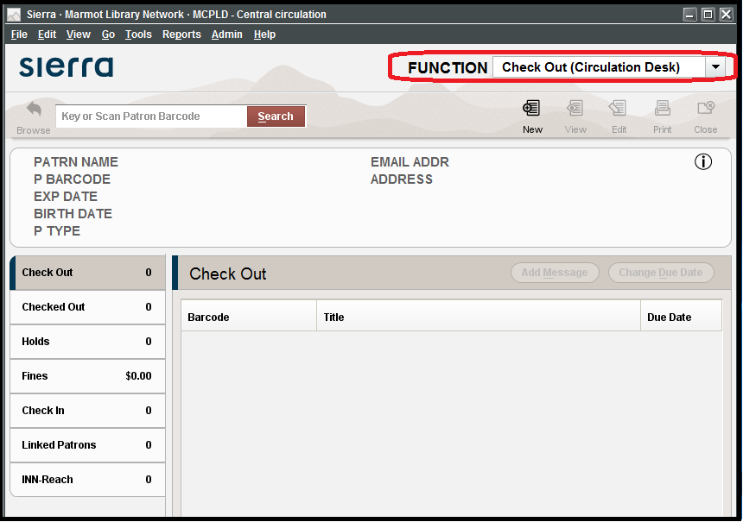
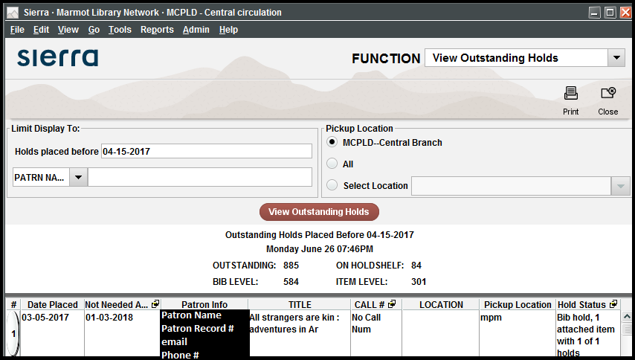
View Holds With 2 ILS Sessions (Sierra)

Slide 7
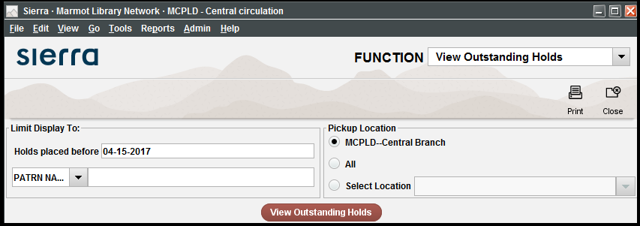
View Outstanding Holds Parameters (Sierra)

Slide 8
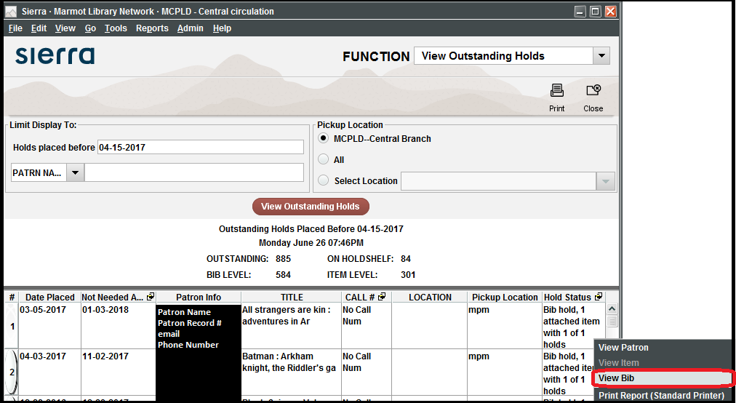
View Outstanding Holds: View Bib (Sierra)

Slide 9
View Outstanding Holds: How?
The following conditions indicate that an item will not circulate and needs additional attention or must be replaced with a different copy:
Item shows the status of billed, missing, or is otherwise blocked from circulating
→ cancel & replace the hold with a different copy, if possible.
If replacing the hold is not an option, send a hold cancellation notice to the patron when prompted upon cancelling the hold.
Item has been in-transit for too long and is unlikely to reach the patron
→ notify owning library / create a report with CLiC (CLiC Website).

Slide 10
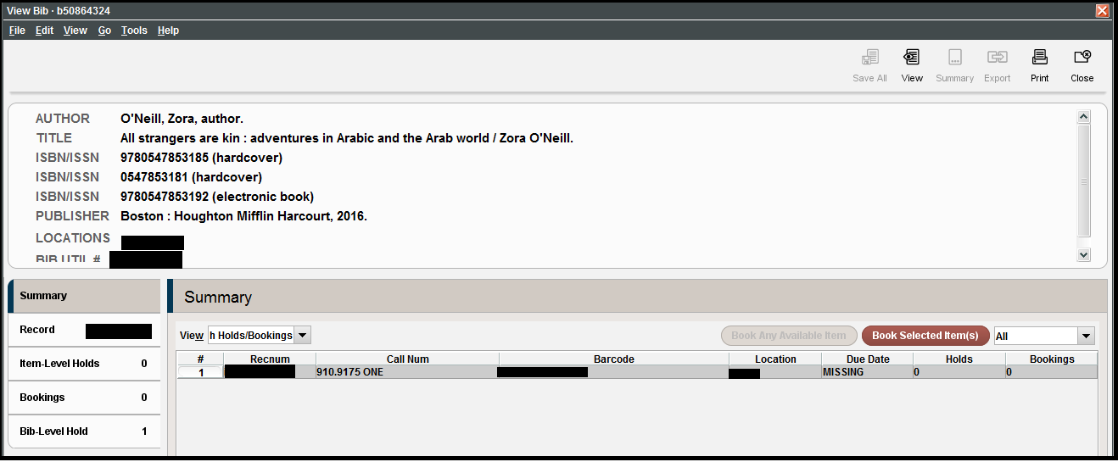
View Outstanding Holds: Bib / Item Records

Slide 11
View Outstanding Holds: Billed Item

Slide 12
View Outstanding Holds: Item on Shelf/ Not Circulating

Slide 13
View Outstanding Holds: How?
The following conditions indicate that an item will not circulate and needs additional attention or must be replaced with a different copy:
Items is in process or has status of on order for several months & has been released
→ notify Collection Management
Item’s last check-in date
→ if several weeks or months ago, replace hold with a different copy
Items that have many holds among your patrons, but few copies should be brought to the attention Collection Management department to determine the need for ordering more copies

Slide 14
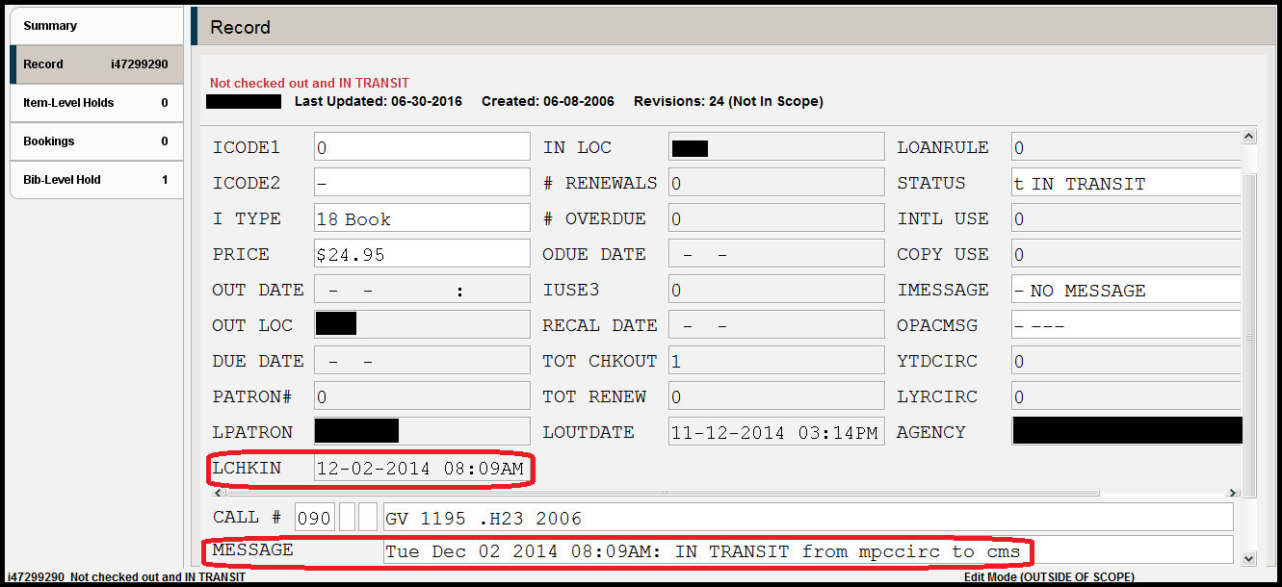
View Outstanding Holds: Item Lost in Transit

Slide 15
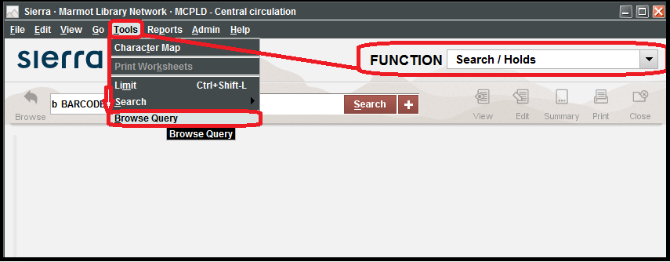
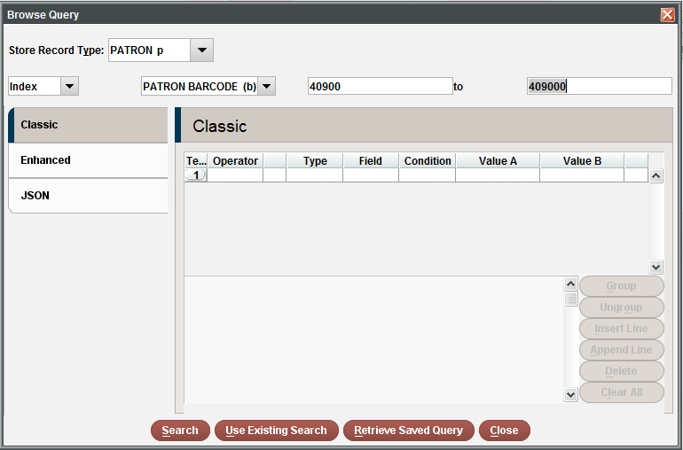
Browse Query Explanation & Parameters
Browse Query is a tool in Sierra that can retrieve patron or item records based on search parameters that library staff can create.

Slide 16
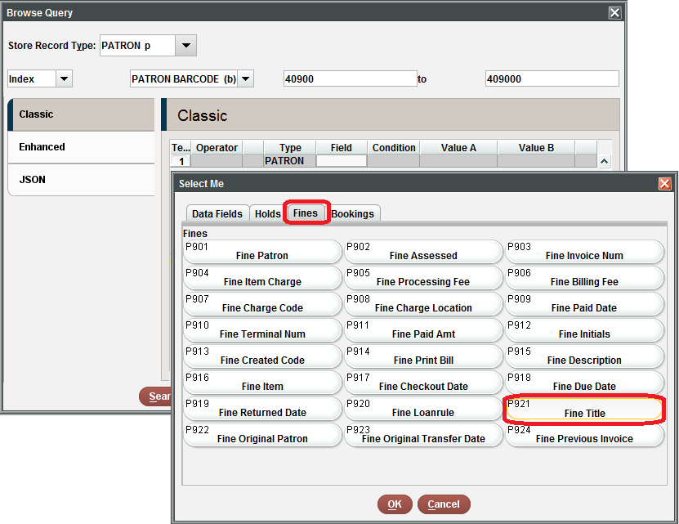
Browse Query
One use might involve finding a patron who returned a long overdue or deleted item within Sierra:
Set the following parameters and weed through the results to potentially find the right account
Compare the Review File results against the returned, billed, or long overdue items on the account

Slide 17
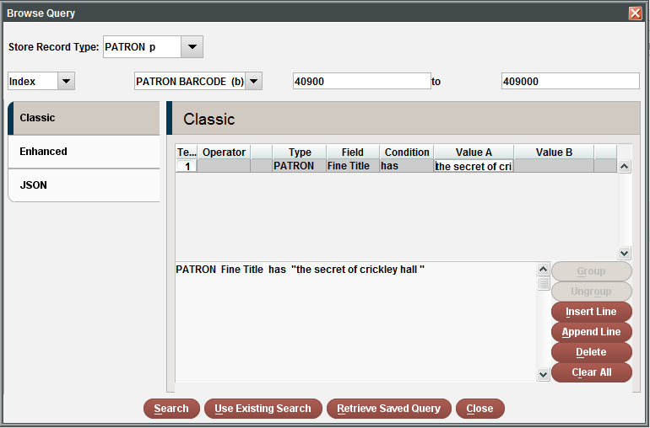
Browse Query - How to find a patron who returned a long overdue or deleted item

Slide 18
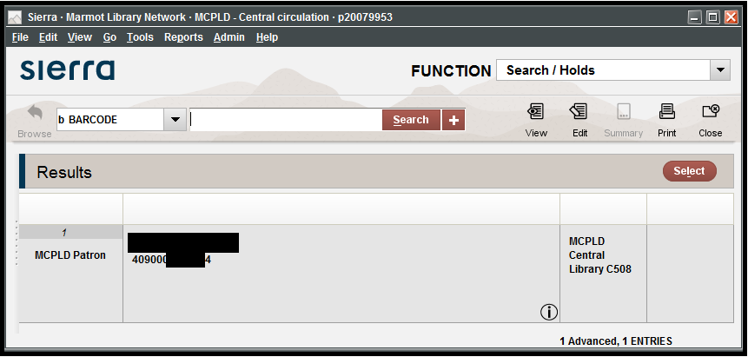
Browse Query - How to find a patron who returned a long overdue or deleted item

Slide 19
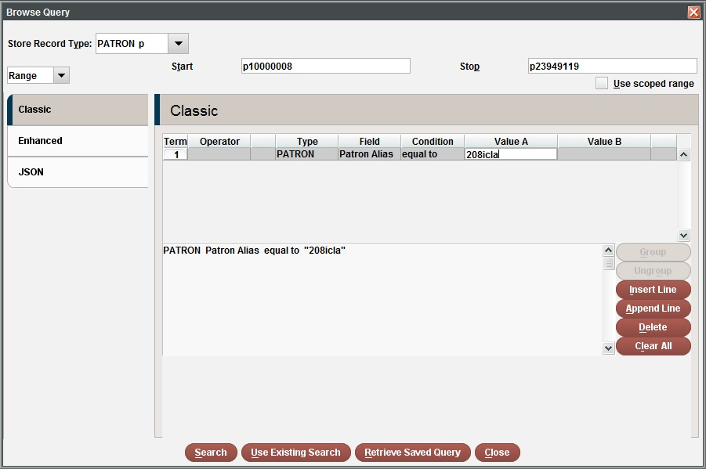
Browse Query - How to find a patron alias

Slide 20
Removing Item Records at WPL
Wilkinson Public Library in the heart of downtown Telluride Colorado
Notes:
Introduce ourselves, Andy Helck programmer, Amy Sieving TS Manager,

Slide 21
How we Delete our old Records
Three-pronged approach:
Delete individual records immediately
Mark individual records for eventual deletion in Global Update
Mark a batch of records for eventual deletion using JSON, Create Lists and Global Update
Notes:
Amy - Why do we remove items?
Deleting records is an ongoing part of maintaining our collection. Our collection development team is always ordering new stuff, but we’ve got a finite amount of shelving, so we’ve got to delete books. There are a few ways that we can delete records, depending on what type of item we’re working with.
Delete right away, mark records for deletions on a ongoing basis, and the new method is to use json to get records into a create list where we can mark and delete them.

Slide 22
Why use 3 different methods?
Each method works best for a specific situation
delete items: we do this for magazines because we don’t need accounting
individual marking: we use this for random stuff that shows up on my desk that needs accounting
batch entry : best suited for big weeding projects also needs accounting
Notes:
Amy
Because we spend the tax payer’s money, we need to account for what goes into our collection and what comes out of it.
This affects how we delete different types of material, and why we have 3 different methods.
Magazines are easiest in terms of accounting. They’re essentially disposable. For auditing purposes, it’s close enough to say that we get in 2000 magazines each year and delete that same amount.
Individual marking is what we use for all of the stuff that needs to be deleted on a day to day basis. A DVD that’s not in a case, a book that’s damaged, duplicate copies of old bestsellers, you get the idea. This stuff is marked to be deleted by lots of staff members, then I do the accounting part and the actual deletion at the end of each month.
Batch entry is for big weeding projects. For us, these tend to happen during spring and fall off-seasons. People will roll down carts packed with deletes, and whoever is at the desk will scan the barcode into a text file and sharpie the withdrawn marks onto the book.

Slide 23
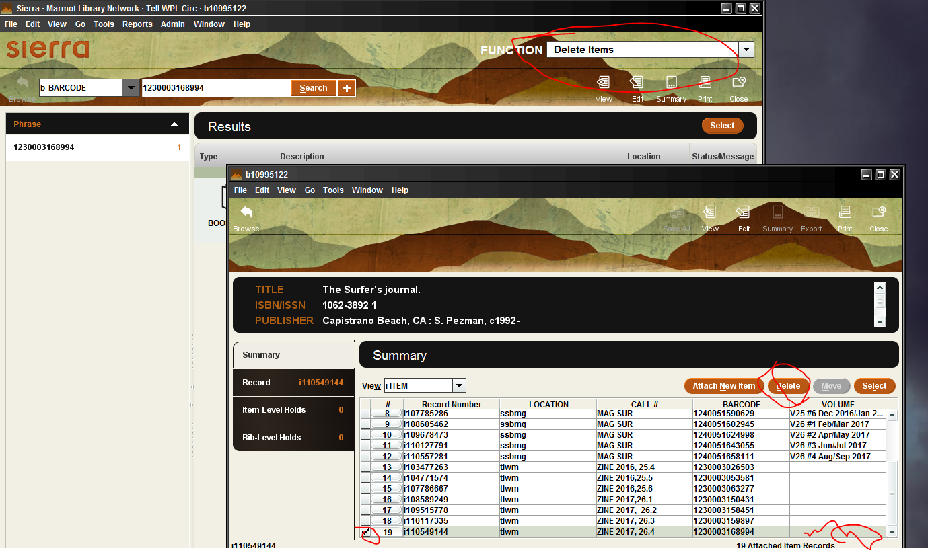
Sierra Function: Delete Items
We all know how this works, the record is immediately removed
Notes:
Amy
Audience Participation: Any questions about what I’ve covered so far?

Slide 24
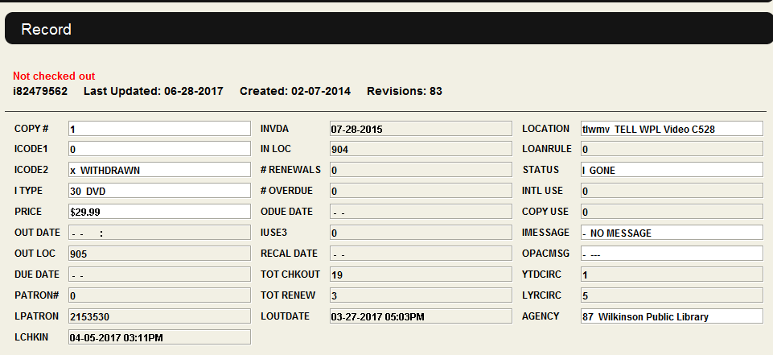
Marking Records as Withdrawn
For most items we will mark a record to be deleted at the end of the month. We keep the record in the database but make sure it is suppressed.
Notes:
Amy
Discuss: ICODE2 and STATUS fields
Discuss: Withdrawing as a verb
For the most part the way that we deal with removing records is actually marking them as withdrawn. For us, that means icode2=x and status=l, you guys might have different ways of marking records, it doesn’t matter as long as you can find them later, and they’re not showing up on pick lists. So throughout the month lots of people will mark items as withdrawn and then at the end of the month I’ll run a create list for all items with icode2=x
That allows me to 1. make sure we’re accounting for everything that goes out for the auditor 2. make sure that I delete associated order records at the same time and 3. kind of keep an eye on things and make sure nobody’s trying to delete anything shady. Like, if we hadn’t done an audiobook weed in a while but there were 30 playaways in my list to delete, I’d want to investigate that. It doesn’t come up often, but it’s a good way to empower staff to take care of deletes while also keeping full control.

Slide 25
Oh no, this is hard work!
Editing a record by hand is tedious, especially when we just want to get rid of it! We have to scan the item, open the record, find and fix the two fields.
Errors are easy to make when you are doing more than a handful of these.
Is there a better way?
Notes:
Amy
Marking individual records takes forever. It sucks no matter which method you use. Is there a better way? One way that’s slightly faster to mark withdrawals is using a macro, and another much faster method is batch scanning barcodes.

Slide 26
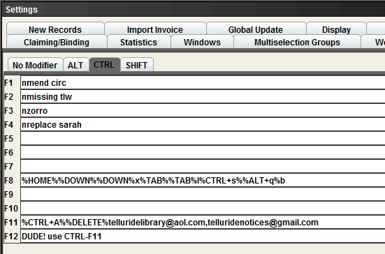
Sierra Macro to mark items for withdrawal
This is where we can define hot keys. CTRL-F8 will issue the keystrokes indicated. It took a bit of trial and error to work out the keys required to highlight the proper fields, insert the data and then save and close the record.
To use the macro go to 'Search Holds' mode and scan your item. When the record comes up just hit CTRL-F8 and the necessary changes are made.
Notes:
Andy
Discuss:
What are macros?
Ease of use -- non-specialist staff
Creating and maintaining -- specialized skill sets required!
Macros are a way of handling repetitive tasks in Sierra. A macro is a string of keystrokes to be entered into a record or open Sierra window. Normally when we edit a record we use the mouse to select a field, click to make a change with the keyboard, click on another field, click to save. But if you play around you can sometimes find a pattern of keystrokes using arrow keys, the TAB key that will move the cursor through the various fixed fields in the record. If you can find such a pattern, you have the beginning of a Sierra Macro.
In Sierra a macro then gets associated with a particular function key, like F8 or CTRL-F2. This way when you open a record for editing, you press that function key, and each of the individual keystrokes you specified is sent in turn. The macro might include CTRL-S to save and ALT-X to close a record.
We've added a bunch of item record macros to our login that help us change new books into regular fiction, mystery, biography or non-fiction. Additionally we've got a macro that alter the fields in an item record to indicate that the item has been 'WITHDRAWN'

Slide 27
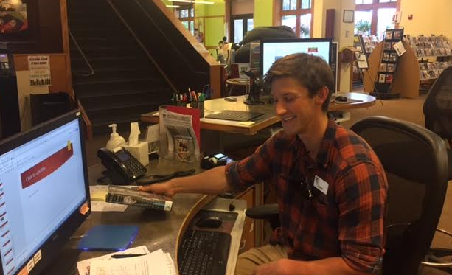
Sierra Macro
Hank is withdrawing books. Isn’t he having fun!
Notes:
Andy Audience Participation: Most of use macros everyday to switch functions. How many libraries are writing their own?
Macros can be difficult to write and debug, but once in they are easy to teach. We've got a cheat sheet for staff on the clipboard. Because marking records to be withdrawn is so similar to the regular 'status changes' that we do when our new items are not quite new anymore, most of the staff are quite comfortable with the process

Slide 28
Any questions?
Notes:
Andy. Take Questions

Slide 29
Batch marking item records
Review lists are great -- you can use Global Update to make all the ICODE2 and STATUS field changes at the same time. But creating a list directly from a cart full of books has always been Sierra’s weak point.
Good News! Now it is possible to create a list simply by scanning the item barcodes into a text document!
Notes:
Amy
There are many chores in the library where a staff member starts with a cart full of books that they have gathered up and need to get all of those barcodes into a create list.
examples:
New books or DVD’s from 3 months ago that need a status change to go into the general collection
Pulling items from a general collection to form a special collection. Example create a Travel section by pulling books from Nonfic
Items to be Withdrawn
I’m sure there are lots of examples that we could come up with where it would be super helpful to magically transport a bunch of barcodes into a review file, but Sierra hasn’t allowed this until recently. Tammy showed one way to create barcode lists at last year’s MUG, and yesterday Lloyd showed us yet another way. Here we will show you yet another way to get the same result.

Slide 30
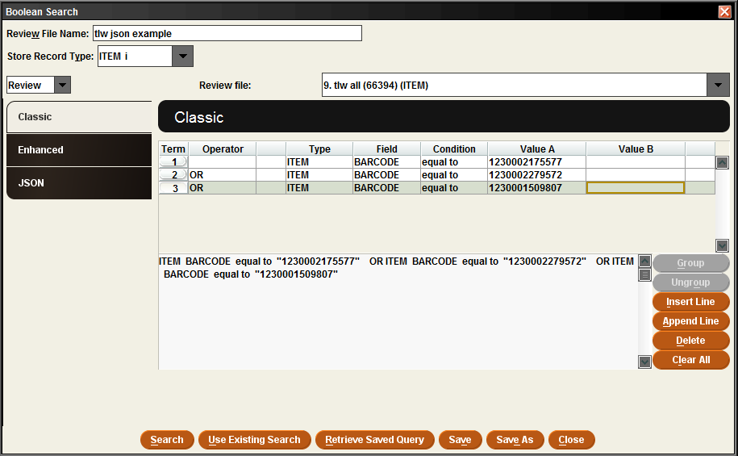
JSON - cool new way to Create Lists!
Using ‘Classic’ search criteria it is possible to search the database against a set of barcodes.
But let’s be real, inputting the barcodes this way would be a nightmare!
Notes:
Andy
yesterday Lloyd showed us that Sierra Create Lists now supports the ‘IN’ operator. This means when writing a search, we can ask to find all records where some field is in a set of values. So if that set of values is a hundred barcodes, Sierra will search the database for all the records which have a barcode matching one of those hundred values.
Lloyd showed us how we can use one of the 2 new tabs in the Create Lists window, the one called ‘Enhanced’ and enter the barcodes directly into the search window. Our approach is to use the other new tab, the one called JSON, and paste the barcodes in after a bit of pre-processing.

Slide 31
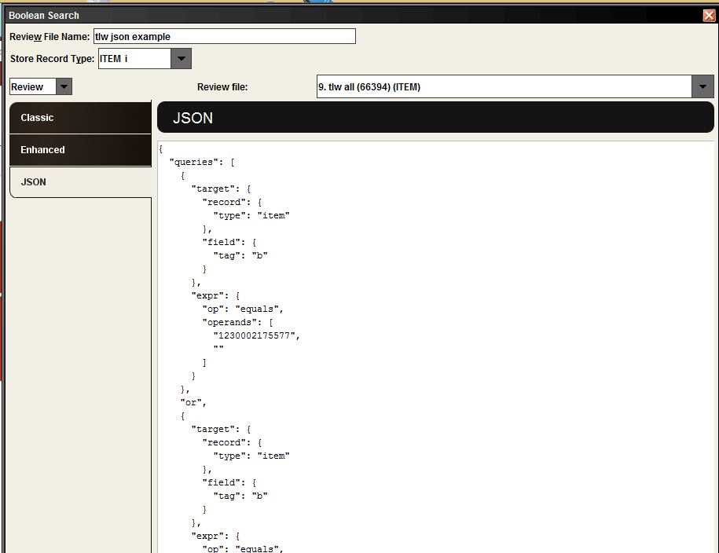
JSON: The Good, the Bad, the Ugly
At first glance, this JSON method may look worse. But you don’t need to understand JSON to use it!
The beauty is that all of this computer code can be pasted into the Create List dialog box. What if there were a tool to create this JSON gobbledegook for us?
Notes:
Andy
Discuss: The real problem with Classic mode is you cannot copy the criteria in or out. JSON mode changes that!
What is JSON? it’s a text format widely used in the website/javascript world to organize all kinds of data. III engineers have chosen this format to organize search criteria. The braces and indentation are off-putting at first but they simply organize all the data.
Note: As both Lloyd and Brandon mentioned yesterday, you can put in your search criteria in Classic mode, switch to JSON and copy out the code. Save it in a file on your desktop. Copy it back in next month and you’ve got your search without retyping the criteria!

Slide 32
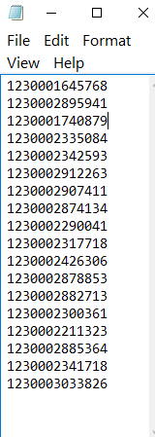
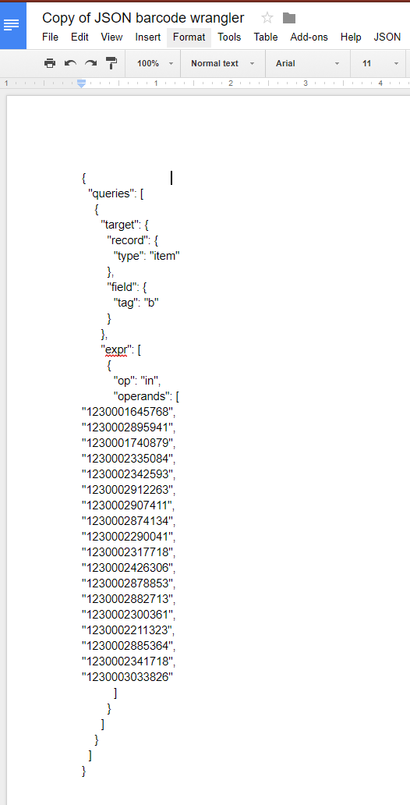
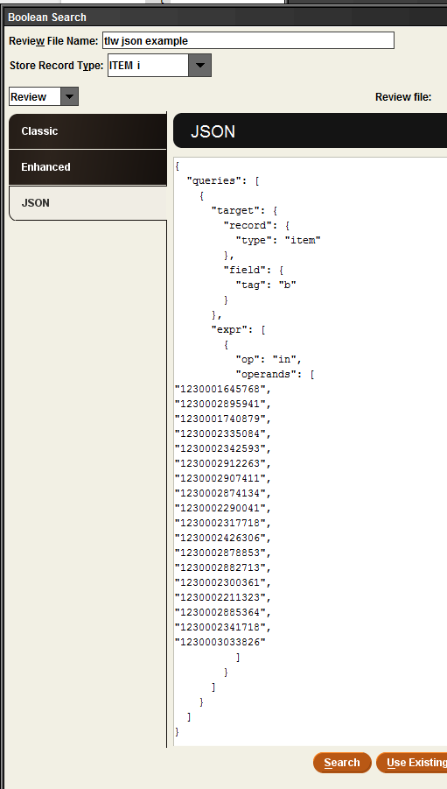
JSON - handy google converter tool
1. Scan barcodes into a text file
2. Copy and paste into JSON wrangler. Click ‘item barcodes’
3. Copy barcodes and formatting, paste into create lists
Notes:
Amy
Discuss: JSON workflow
So wouldn't it be nice if we could just paste the list of barcodes directly into the Create Lists window? Unfortunately, there is some JSON code and some formatting that needs to be applied to the barcodes first. Andy created a simple tool to do this and it’s super helpful. We've chosen to use Google Docs to write our converter because it simplifies sharing the data amongst staff.
So now the steps simply involve scanning barcodes into a text file, opening up the converter tool in Google docs, pasting in the barcodes, selecting the ‘item records’ button - then all of the formatting gets applied, then you’re ready to copy and paste into create lists

Slide 33
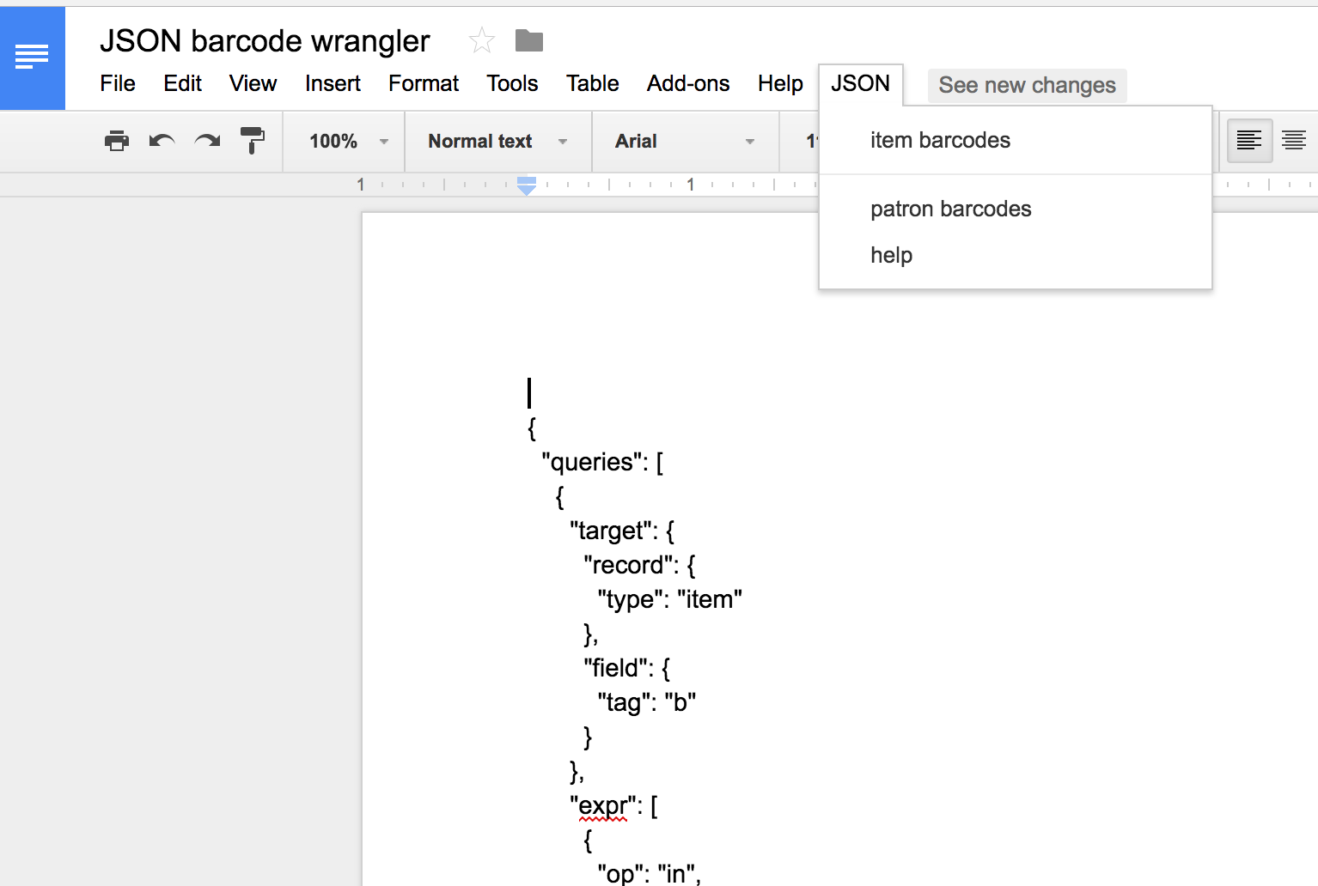
Barcode Wrangler in Google Docs
Get a copy!
https://goo.gl/QqDpZg
Notes:
Andy
Discuss: Google Docs programming. Javascript language and easy collaboration.
This last year I’ve been learning how to automate tasks in Google Docs and Google Sheets. There is a very nice scripting language built into every document and spreadsheet. It is called Google Apps Script, but you may already know it if you program in JavaScript. If not it is pretty easy to learn. Of course you don’t have to know how to write a script to use it, so lets concentrate on that.
So to pre-process the barcodes into JSON format, I wrote a script and put a link to it in the menu bar. The script pulls out anything that looks like a barcode and then formats all those barcodes into the correct JSON gobbledegook.
The script ignores anything that is not a barcode, so you can run the script over and over again, add more barcodes, write yourself a note, etc.
time for live demo, JSON wrangler, email, Sierra

Slide 34
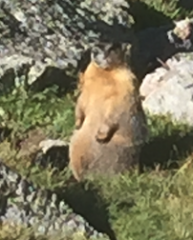
Monthly Maintenance
Regardless of how the staff are withdrawing items throughout the month, it’s Amy’s job to actually remove these items from the database. So at the end of the month we go back to Create Lists, and do a straightforward search for items that are marked as withdrawn.
Because we use the Acquisitions module, there is also some work to do with the Order records.
Notes:
Amy
So, now during the month various items have been marked for withdrawal through various methods, I have to make sure that I actually delete these records at some point, rather than just leaving them marked withdrawn. This is a good time to review items before actually deleting them - that’s where I can sort of supervise what’s being deleted while letting service specialists do the marking.
We keep track of the prices of items entering and leaving the database for auditing purposes, if anybody is interested in this come see us after.

Slide 35
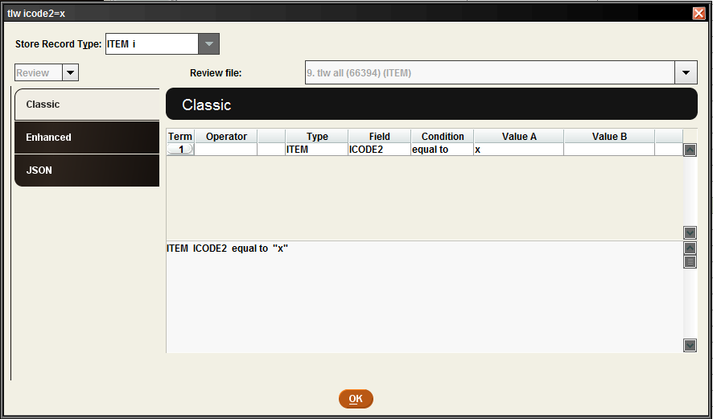
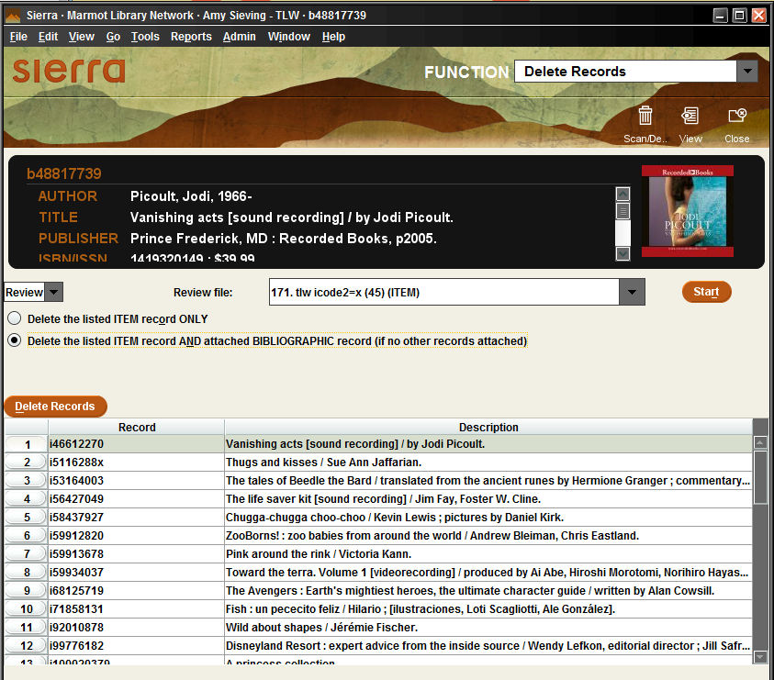
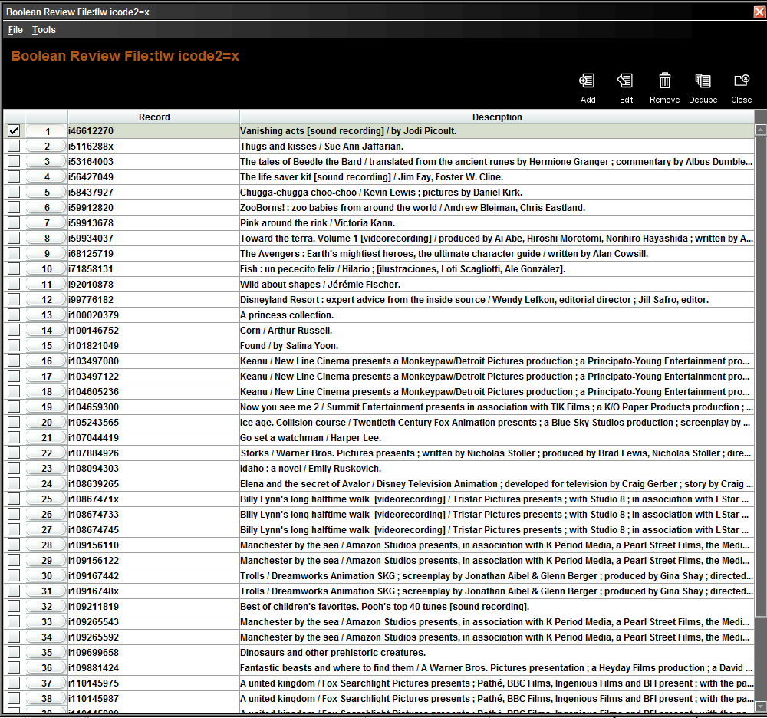
Delete the Withdrawn Records
Notes:
Amy
So, let’s finally get these records out of the database. At the end of each month, I run a list to gather up all of the items that we’ve marked as withdrawn. It’s a super simple list, just looking for icode2=x. From there, I do a quick scan in global update to make sure there aren’t any weird itypes or locations, then I do a review list to find and delete the associated order records, then go to ‘delete records’ function in sierra and go for it. Just a note of caution - always scan to the bottom of your list to make sure you’re deleting the right number of records. I also like to check one or two item records to make super super certain they’re mine.

Slide 36
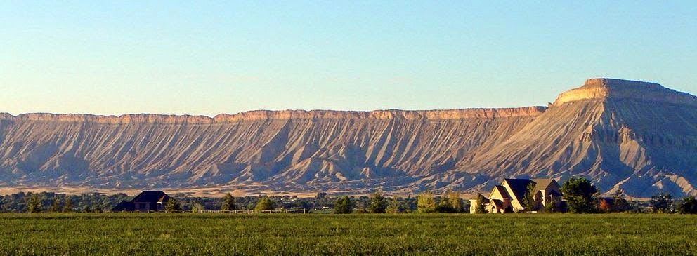
Thanks for coming!
Austin Mullenix amullenix@mcpld.org
Amy Sieving asieving@telluridelibrary.org
Andy Helck ahelck@telluridelibrary.org
Notes:
Audience Participation:
Thanks for attending!
Questions for Austin, Amy or Andy?
email Andy or Amy if you want access to the JSON Wrangler. Please make a copy!

